Slide 1
SQL vs NoSQL

Slide 2
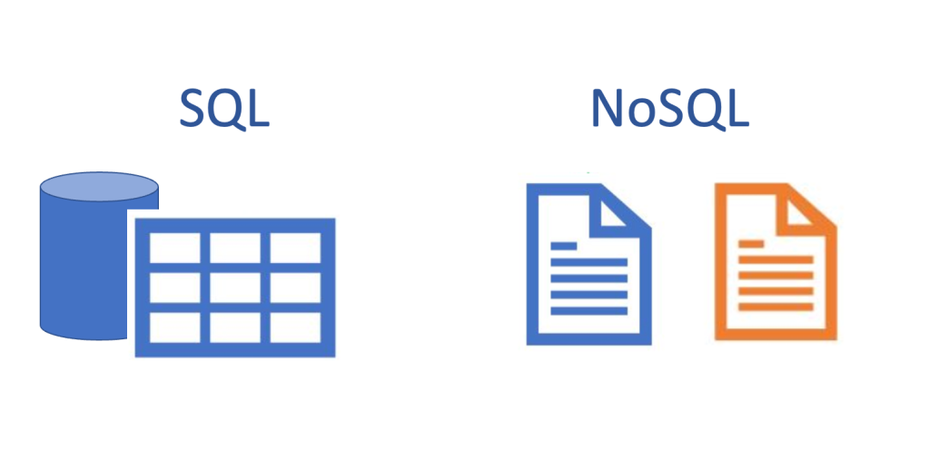
Introduction
When we create a database, we have to choose between SQL and NoSQL. But what are the differences between these two types of databases? How do they work differently?
In this presentation, we will compare MongoDB, which is a NoSQL database, with SQL, which is a relational database management system.

Slide 3
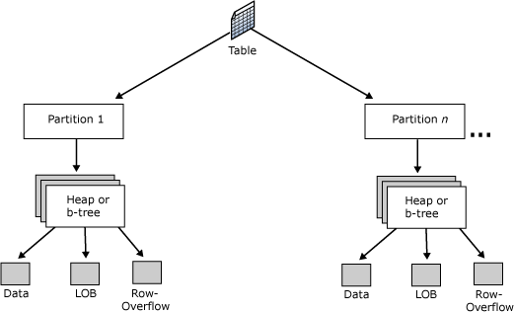
What is SQL
SQL, which stands for Structured Query Language, is a type of relational database management system.
It is a widely used technology for managing structured data in a tabular format.
SQL databases use tables with predefined schemas to store and manage data.
SQL databases are based on the relational model, which involves establishing relationships between tables using keys.
SQL databases can be vertically scaled, which means adding more resources (such as CPU or memory) to a single server to handle increased data storage and traffic loads.
SQL allows for powerful querying and manipulation of data using SQL queries, which are written in a structured language.
Some popular SQL databases include MySQL, PostgreSQL, Oracle, and Microsoft SQL Server.

Slide 4
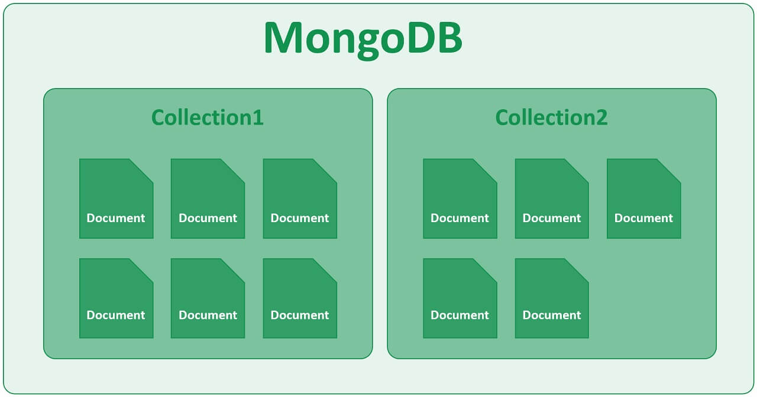
What is MongoDB
MongoDB is a type of NoSQL database, which stands for "not only SQL".
It is a document-oriented database that stores data in a flexible, JSON-like format called BSON (Binary JSON).
MongoDB is known for its ability to store unstructured data, making it suitable for handling large amounts of diverse data.
MongoDB does not require a predefined schema, allowing for dynamic and flexible data storage.
MongoDB is highly scalable and can handle large amounts of data and high traffic loads.
MongoDB's horizontal scaling makes it suitable for handling big data, real-time analytics, and applications that require high performance and high availability.

Slide 5
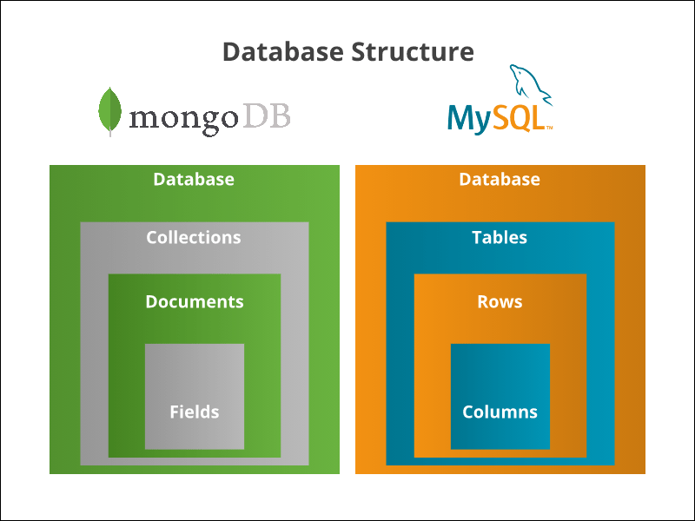
Differences: MongoDB vs SQL
A SQL database processes SQL queries, whereas MongoDB offers JSON querying. MongoDB is a more dynamic and complicated choice that is appropriate for hierarchical data because of its fundamental properties, as opposed to a SQL Database, which is still more predetermined and appropriate for other types of data storage.

Slide 6
Use Cases: MongoDB vs SQL
MongoDB
Social media platform: Suitable for building social media platforms that require handling dynamic and evolving data, such as user profiles, posts, comments, and media content.
Real-time chat application: Ideal for building chat applications that require instant messaging, notifications, and real-time updates.
E-commerce website: Can be used to build e-commerce websites that handle large amounts of product data, customer information, and order management.
SQL
Online store: Commonly used for building online stores that require structured data management for products, customers, orders, and payments.
Reservation system: Suitable for building reservation systems for booking hotels, flights, or event tickets, where data consistency and reliability are crucial.
Library management system: Suitable for building library management systems that require cataloging and tracking of books, borrowers, and loan history.

Slide 7


Conclusion
In conclusion, MongoDB is a flexible NoSQL database suitable for unstructured data, while SQL databases are commonly used for structured data management. Consider your data type, scalability needs, and application requirements when choosing between MongoDB and SQL.

